Slide 1

Seasonal Agriculture Performance Analysis
Student Name: Kartik Soni
College Name-Government Engineering College Bikaner
AICTE STU ID : STU6a63a80d4ea911784915981

Slide 2

PROBLEM STATEMENT
Agricultural performance is shaped by seasonal shifts in rainfall, temperature and resource use, but raw farm data does not, on its own, show how these seasons actually differ or why.
Across 4,000 farm records spanning Kharif, Rabi and Zaid seasons, it is unclear which season carries the greatest financial risk, what drives that risk, and whether the answer is the same for every crop and region.
This project analyzes the dataset to uncover meaningful seasonal patterns and translate them into evidence-based recommendations for agricultural planning.

Slide 3
Project Description
Data Cleaning: Loaded the 4,000-record dataset into Pandas and filled missing Rainfall, Soil Moisture and Yield values using group-wise medians (by State-Season or Crop) instead of a single global average.
Feature Engineering: Created Profit_Margin_pct (Profit / Revenue) and a Loss_Making flag to compare profitability fairly across crops of very different scale.
Exploratory Analysis: Grouped and visualized rainfall, yield, profit, disease risk and irrigation efficiency by season, then used a one-way ANOVA test to confirm which seasonal differences were statistically significant.

Slide 4

WHO ARE THE END USERS?
Farmers & Agronomists: Use seasonal risk patterns to decide which crops and irrigation methods to plan for in Zaid, where 64.5% of farms currently lose money.
Government & Policy Planners: Target subsidies, crop insurance and irrigation infrastructure toward the seasons and regions shown to carry the highest financial risk.
Agri-Input & Irrigation Companies: Use the Drip-vs-Flood profitability gap (₹2.20L vs ₹0.73L) to promote efficient irrigation equipment where it delivers the clearest return.

Slide 5

Technology Used
Python – Core analysis and scripting language
Pandas & NumPy – Data cleaning, grouping and feature engineering
df.groupby(["State","Season"])["Rainfall_mm"].transform(...)
Matplotlib & Seaborn – Statistical charts and the correlation heatmap
sns.boxplot(data=df, x="Season", y="Profit_INR")
SciPy – One-way ANOVA to test seasonal significance
stats.f_oneway(kharif, rabi, zaid)
Jupyter Notebook – Documented, reproducible analysis

Slide 6
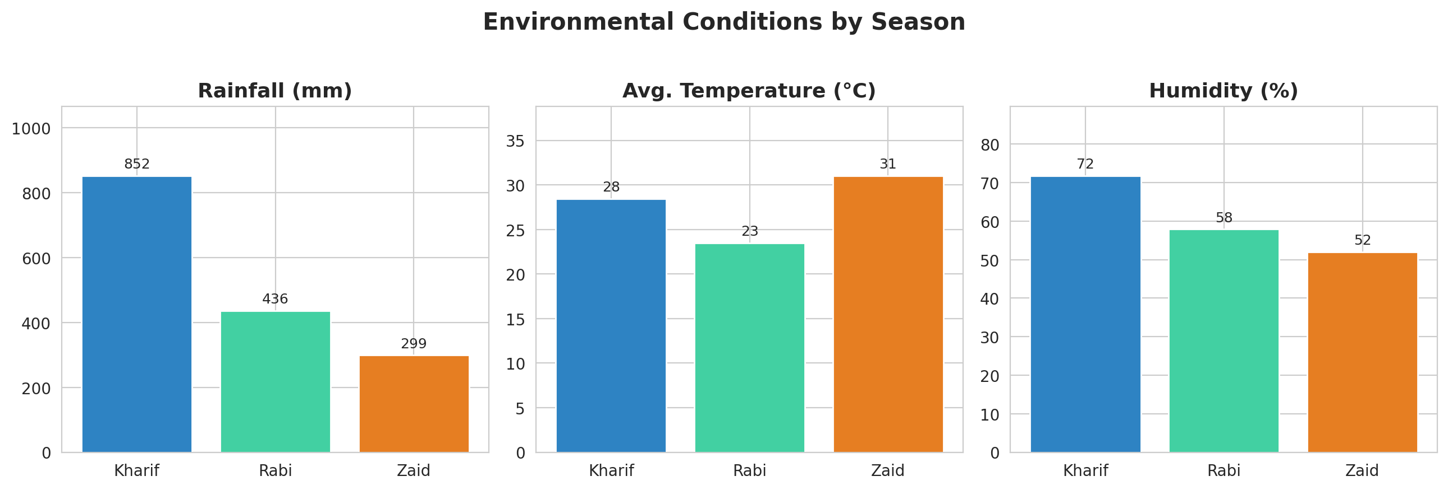
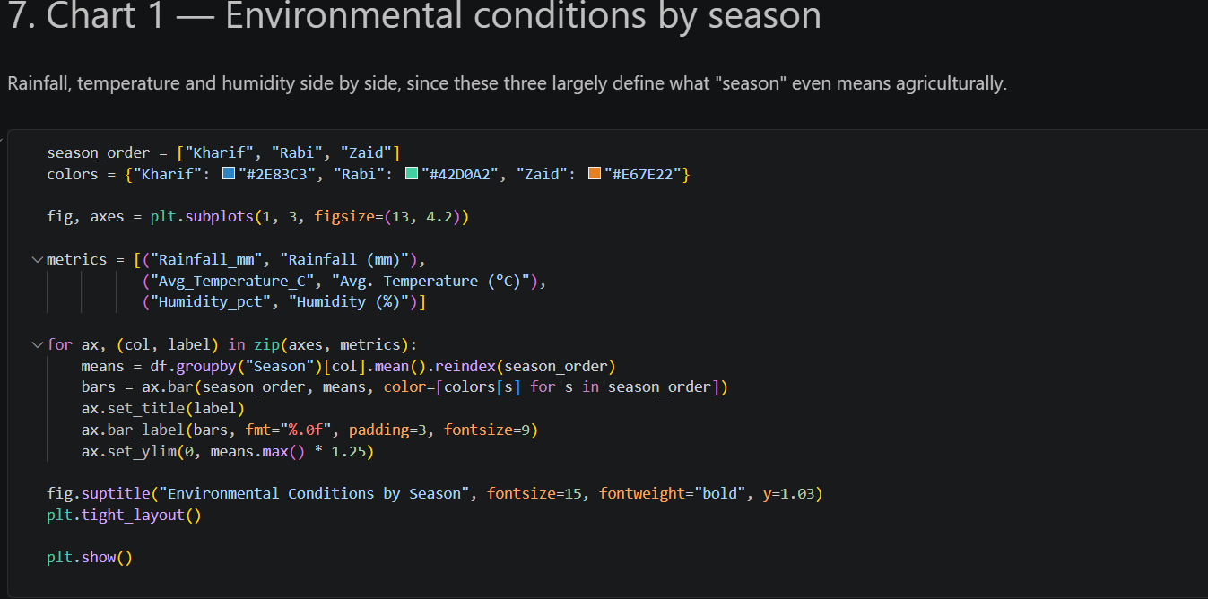
RESULTS
Environmental Conditions by Season

Slide 7
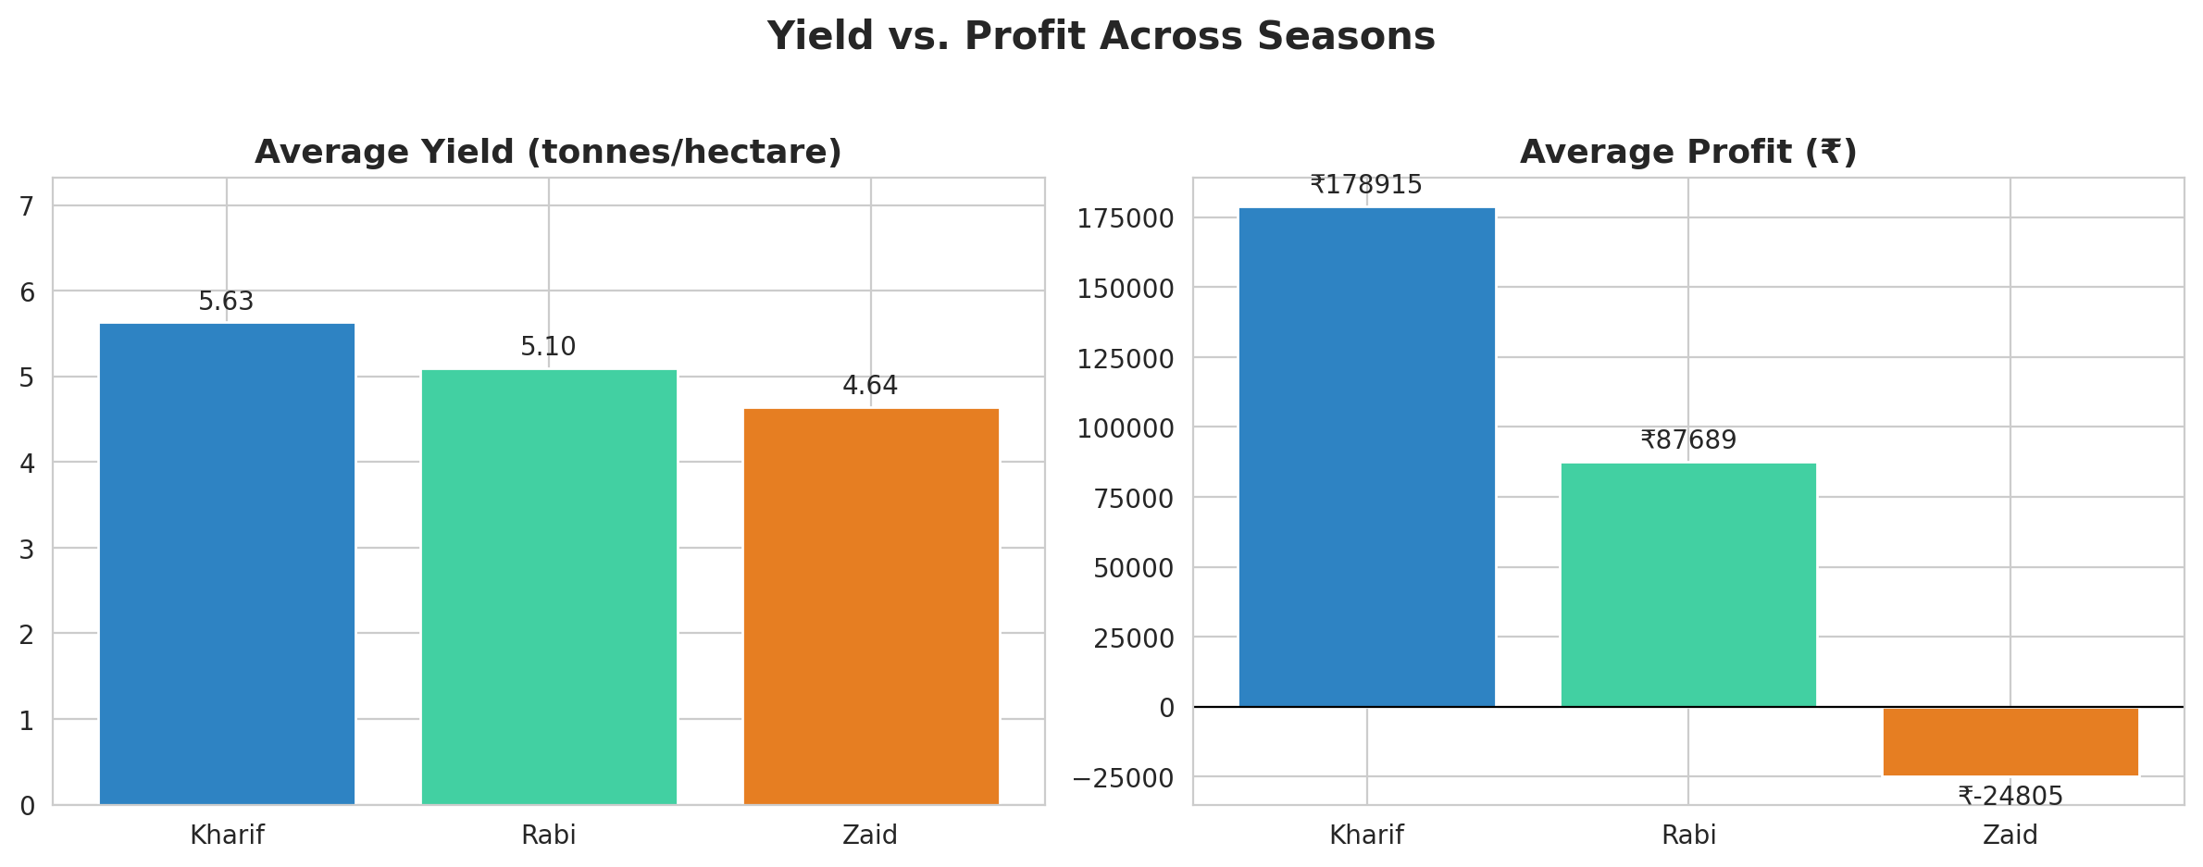
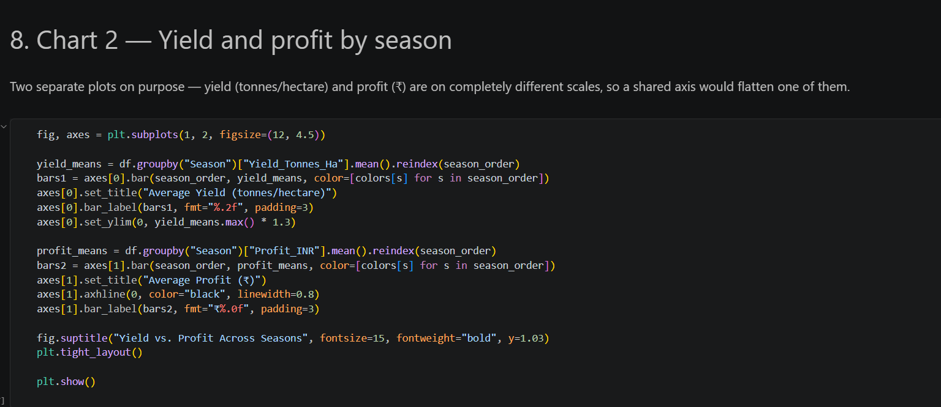
RESULTS
Yield vs. Profit Across Seasons

Slide 8
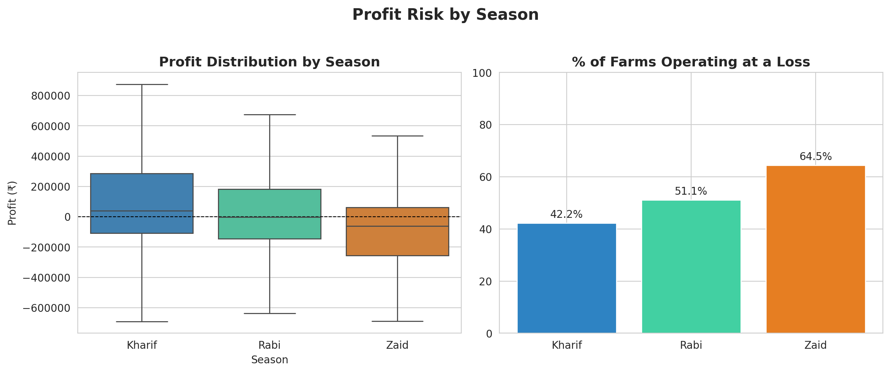
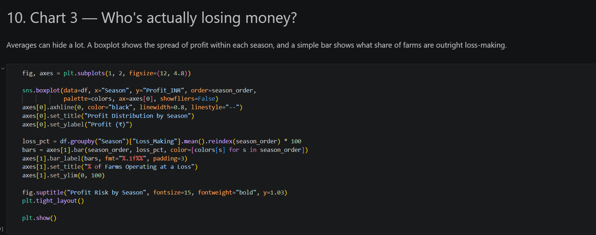
RESULTS
Profit Risk by Season

Slide 9
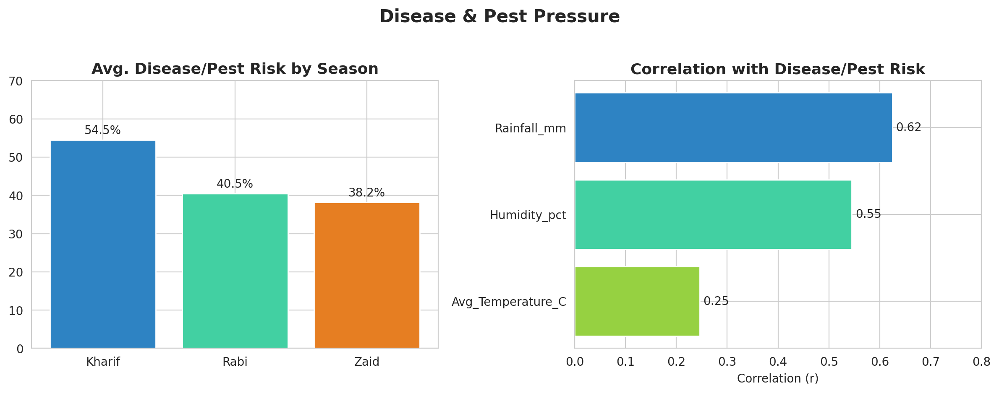
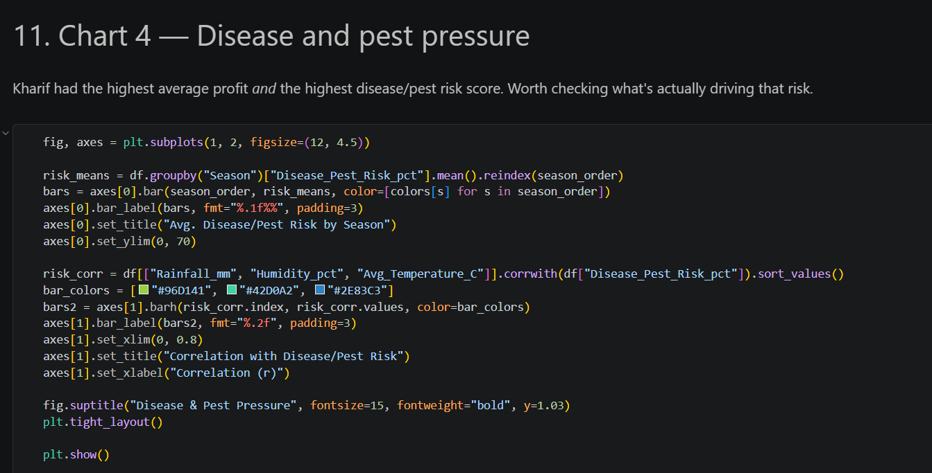
RESULTS
Disease & Pest Pressure

Slide 10
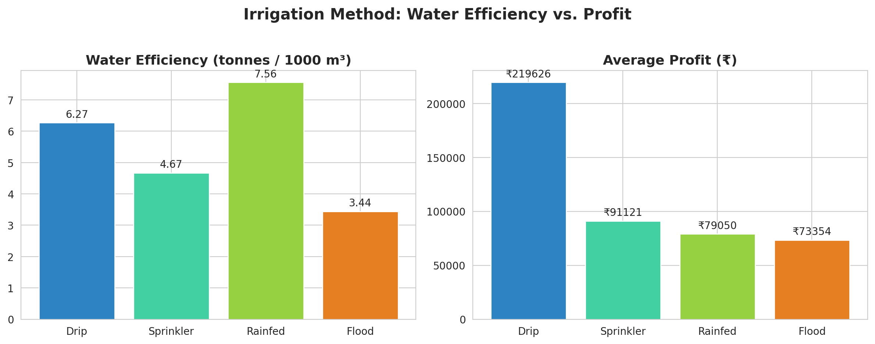
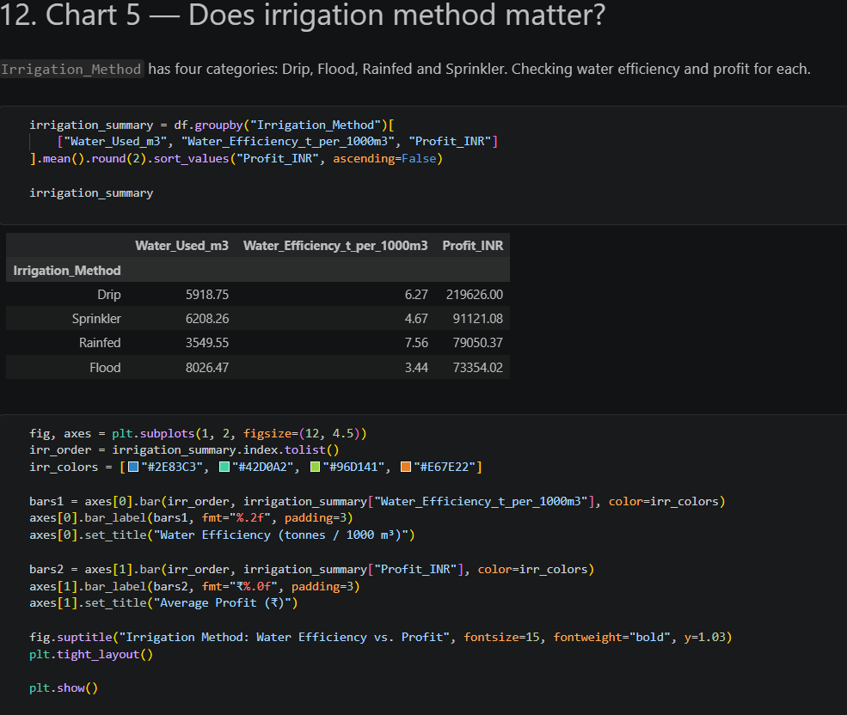
RESULTS
Irrigation Method: Efficiency vs. Profit

Slide 11
Future scope
Predictive Modeling: Build a regression model to predict Profit or Yield from season, crop and irrigation method, turning these findings into an early-warning tool.
Real-Time Weather Integration: Connect live IMD rainfall and temperature feeds to replace static seasonal averages with district-level, up-to-date conditions.
Interactive Dashboard: Turn this notebook into a Streamlit dashboard so farmers and officials can filter by state, crop and season on their own.
Deeper Cost Analysis: Break down Total_Cost_INR into its components to explain why costs stay flat across seasons while profit does not.

Slide 12
GitHub Link
Link - https://github.com/kartiksoni021105-hub/Seasonal-Agriculture-Performance-Analysis.git

Slide 13

VOIS Course completion certificate - Course name- Data Visualization

Slide 14
Thank you
Thank you for your time and attention.
.

